Slide 1


Detecting Invasive Species Signals
Christian Jimenez
Northern Arizona University
Mentor: Katharyn Duffy
Notes:
My mentor Katharyn Duffy and I have been working on an application that detects signals of invasive plant species all over the United States.The purpose of this is to be able to track the growth of these invasive plant species that happen to be very flammable. This will help us to be more on top of forest fires by showing when and where a specific species of plant is most at risk to catch fire and spread quickly. What I have been working on in this project is taking data from different plant species, specifically the different grasses, from different times dating back to 2015 and finding out what time of the year each of these species of grass is at its lowest intensity of greenness and how quickly it deteriorated to that point. We are able to get this data from Phenocam imaging and with this data we know when that area is at risk of a potential forest fire.

Slide 2
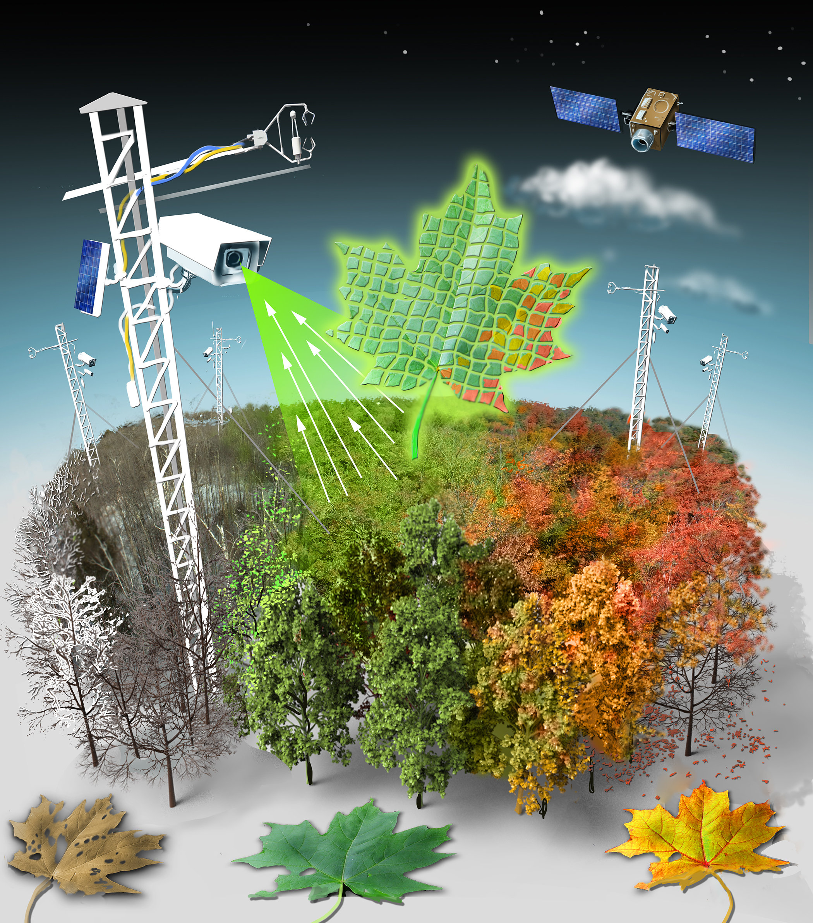
What is Phenocam?
Near surface remote sensing
a digital camera set up at a fixed location to capture time-lapse images.
Creates a wealth of phenology image data of many different ecosystems.
Over time, the data will reveal trends in the growth of different plants.

Slide 3
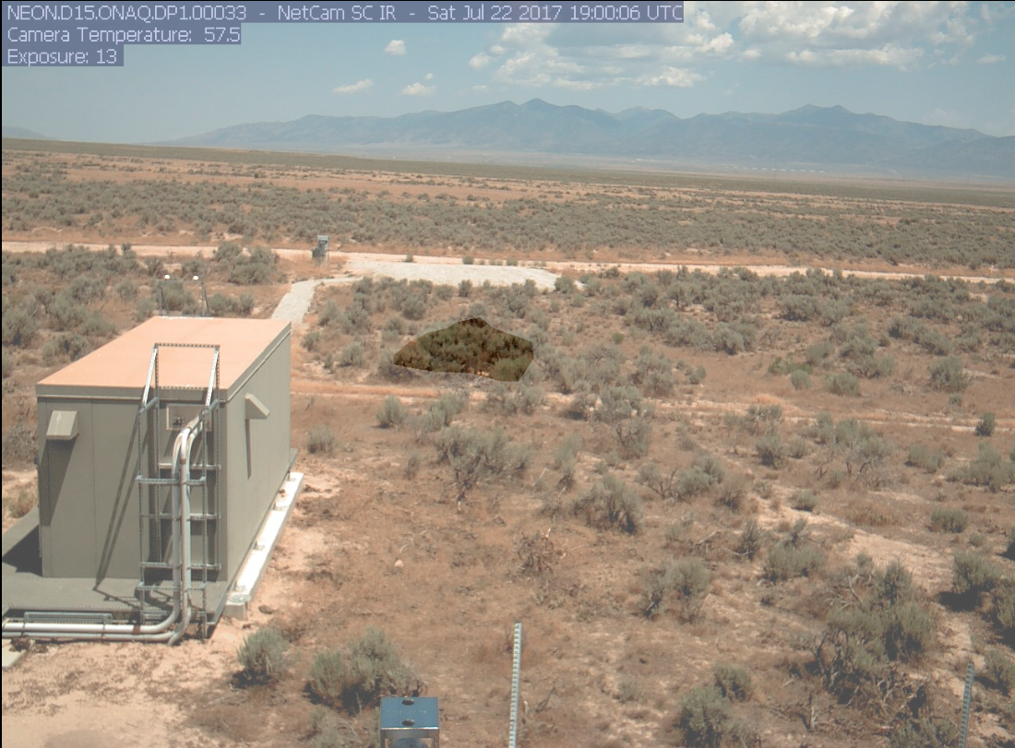
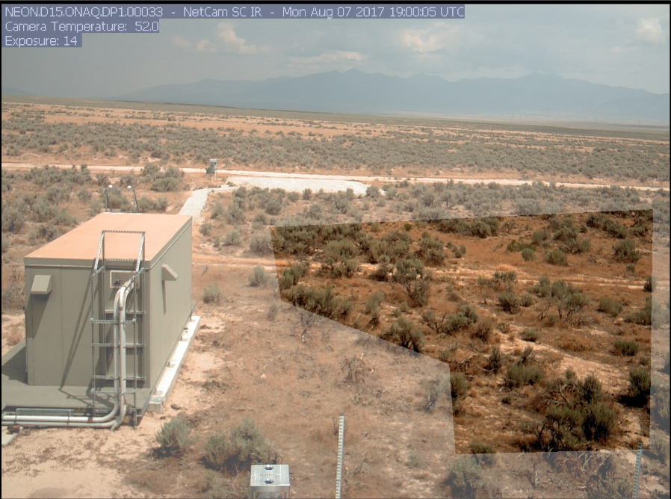
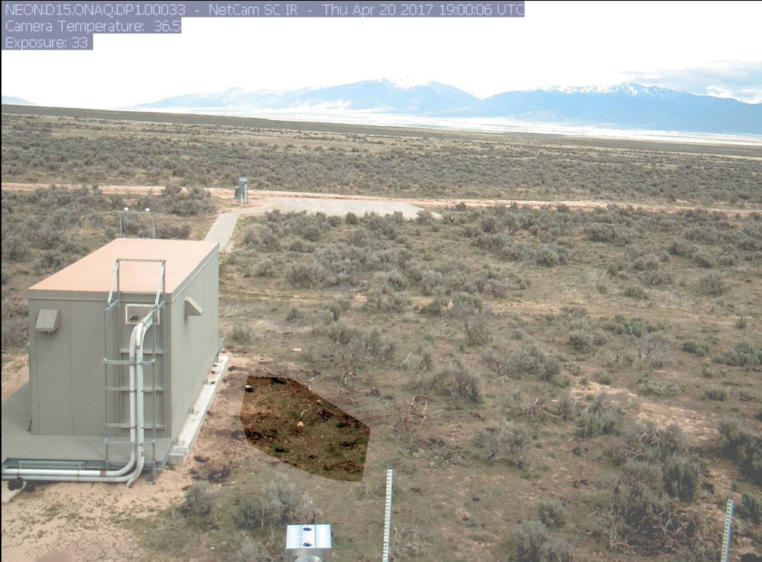
August 2017
July 2017
April 2017
Notes:
Here, we have a few photos from a single location at three different times of the year. In this first photo we can see that this area is at its maximum risk of flammability due to the cheatgrass surrounding the area being at its lowest greenness intensity and the shrubs also being at a lower intensity as well. This photo was taken in August of 2017. The next photo in the top right shows the same area a month prior to the first photo, in July of 2017. It may be hard to tell by just looking at the photo but the shrubs are actually a bit greener, slightly bringing down the risk of a fire in the area. However, the cheatgrass in this area is still quite low in intensity and is still a risk. The last photo here in the bottom right is, as you can see, quite a bit greener. This photo was taken a few months prior in April of 2017. At this point the area was quite healthy with a high greenness intensity in both the grass and the shrubs making the area not at risk of catching fire. It is interesting to see how quickly the plants in the area deteriorate in the summertime. In just 4 months it went from being at no risk to fire to being at a maximum risk of fire. With Phenocam imaging we can choose different focus points in the images to better track specific plants in the imaging. In the July photo you can see that we are focusing specifically on the shrubs. In the April photo we are focusing specifically on the cheatgrass. And in the August photo we are focusing on both the shrubs and cheatgrass.

Slide 4
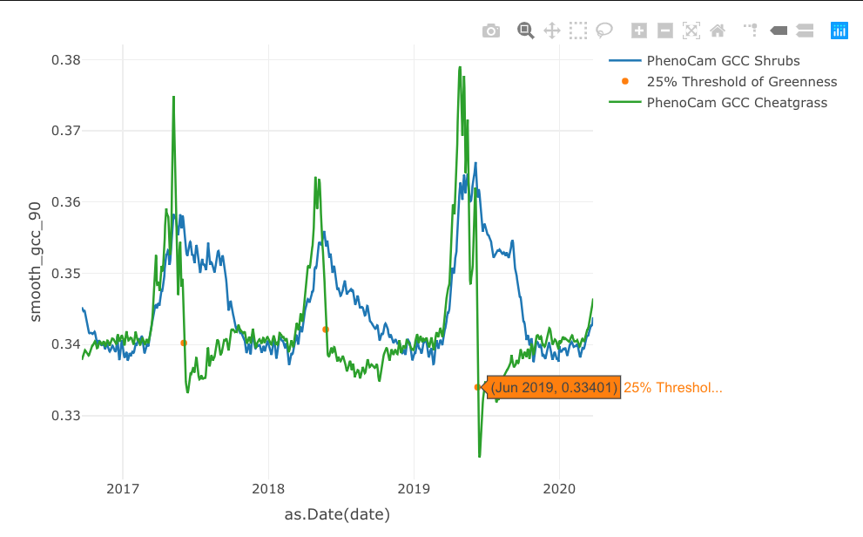
Cheatgrass vs.
Shrubs
Greenness
Notes:
Here, we have a graph comparing the greenness intensity of cheatgrass to shrubs in an area. You can see that during the winter every year, both cheatgrass and the shrubs are quite low in greenness making them at somewhat of a risk of fire. Then as the year progresses, the intensity of both plants climb at a rapid rate in the spring making the area very healthy and green. The intensity of cheatgrass actually becomes much higher than that of the shrubs. This is because there is so much of it multiplying and filling the area with very grass which is not good because just a short time later, the intensity of that grass drops at a very rapid rate to a very low status intensity making all of that brand new green grass that filled the area now extremely prone to catching fire.

Slide 5
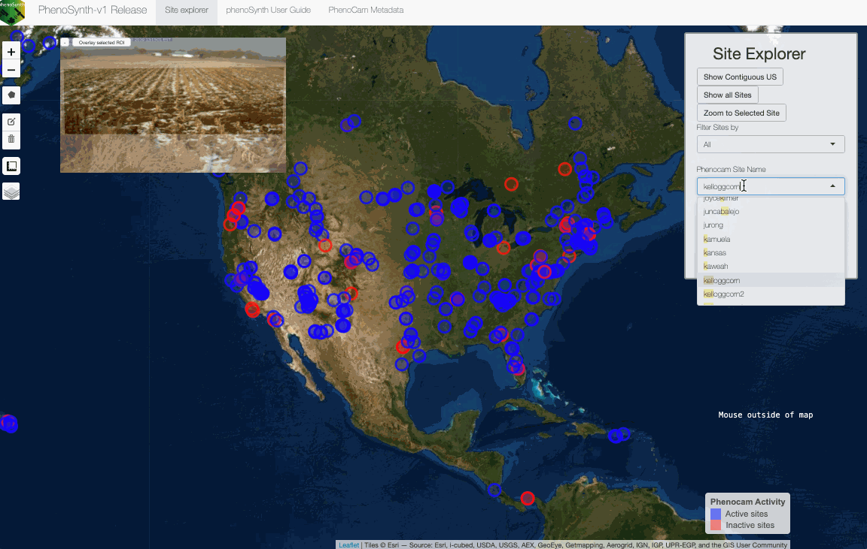
Notes:
Here is a quick presentation of how the PhenoSynth application that we have been working on operates. We start with uploading shapefiles so that we can focus on a specific area that we want to track. Then we choose our desired data types and the frequency of which the phenocam images were captured. We can also choose to see the field of view which the phenocam was able to capture and choose the areas that we want to focus on for our desired data set. We can then choose to look at the graph of either the grass in the area or the shrubs. After we choose plot data we are then given the data trends of the greenness intensity over time which we can use to detect which plants are a threat.

Slide 6
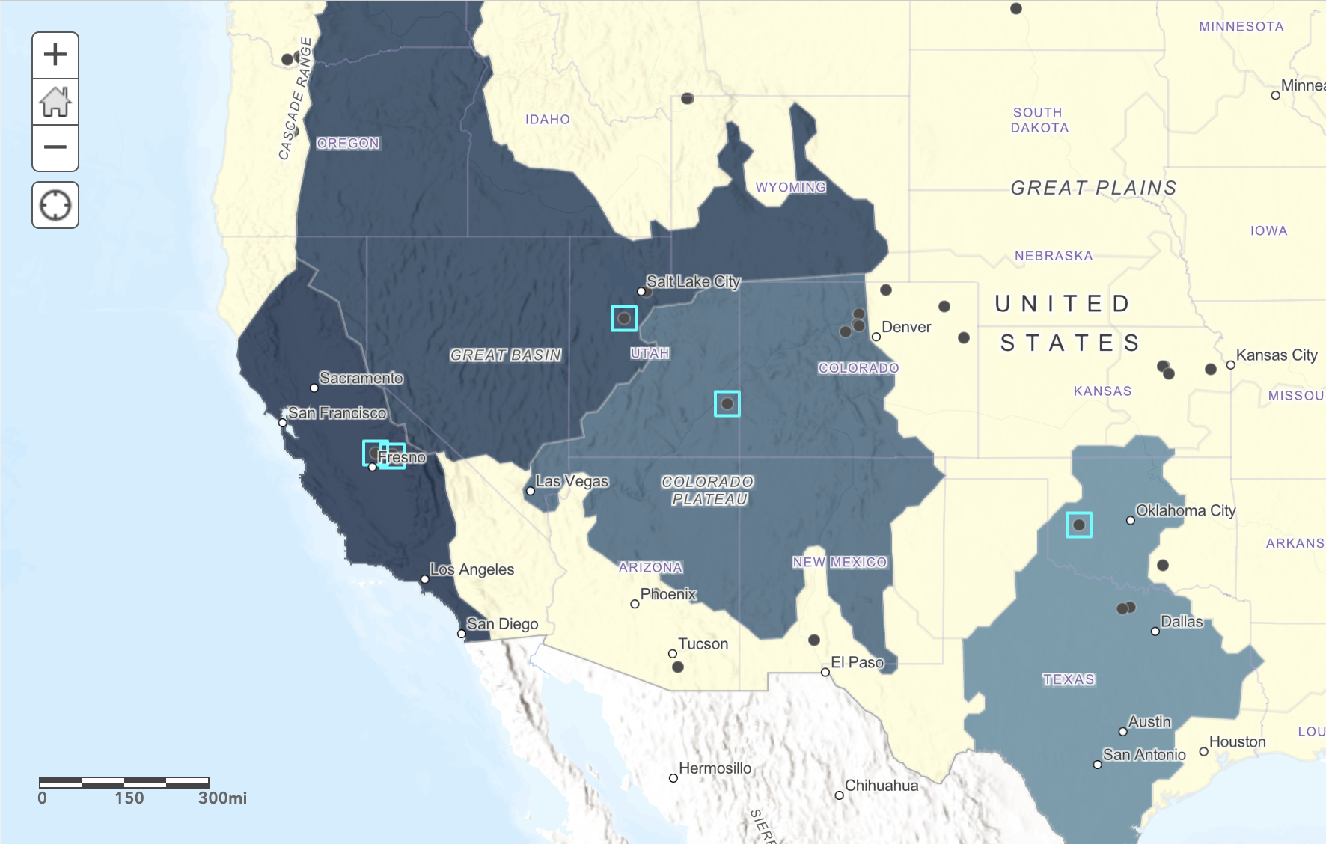
We know that cheatgrass exists at additional sites
Notes:
Here we have a map of other areas where the invasive species, cheatgrass, exists. These are the areas that we will first implement into the application since cheatgrass is a species that is both a threat and is easy to detect because of its unique growth patterns.

Slide 7
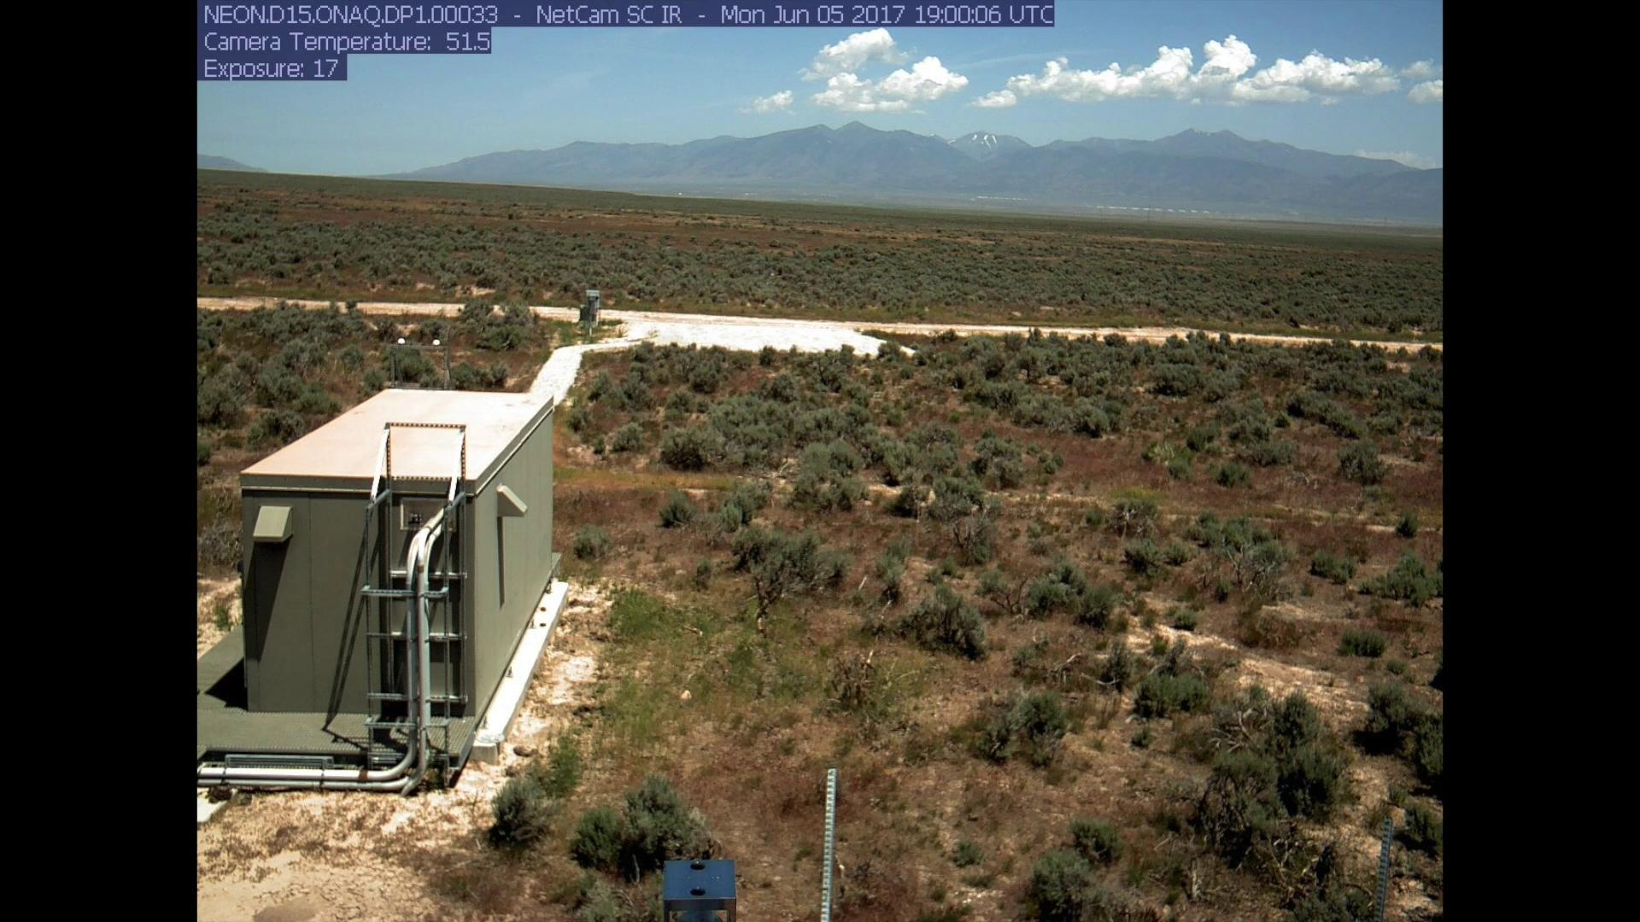
Notes:
Here is a short time lapse video from a Phenocam in the ONAQ site to show the change in growth of cheatgrass here in this area. It starts in March of 2017 and a photo is taken everyday until August of 2017. You can see that at first all of the plants are dead and there is no green. Then about a month later in mid April we start to see some green. Mid-May both the shrubs and the cheatgrass are quite green but then approaching mid-June, the cheatgrass browns down very quickly while the shrubs remain green. That is what is so unique about cheatgrass. Then by the time July comes around, the Cheatgrass is completely dead making it a large risk for this area.

Slide 8
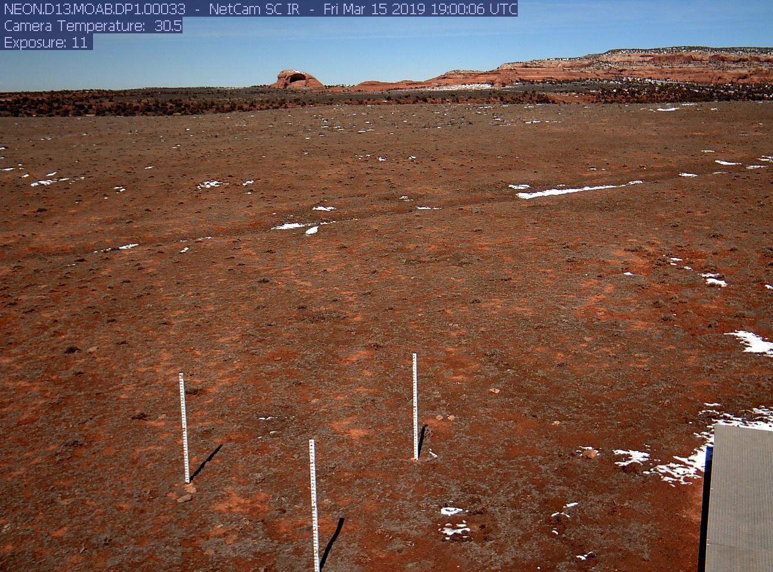
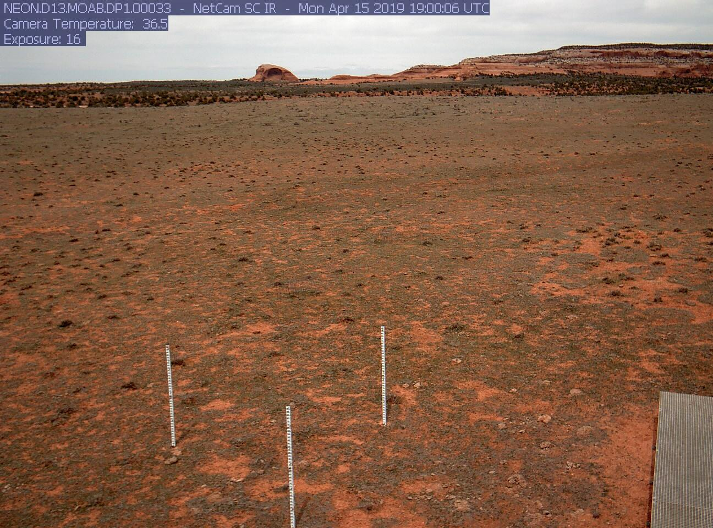
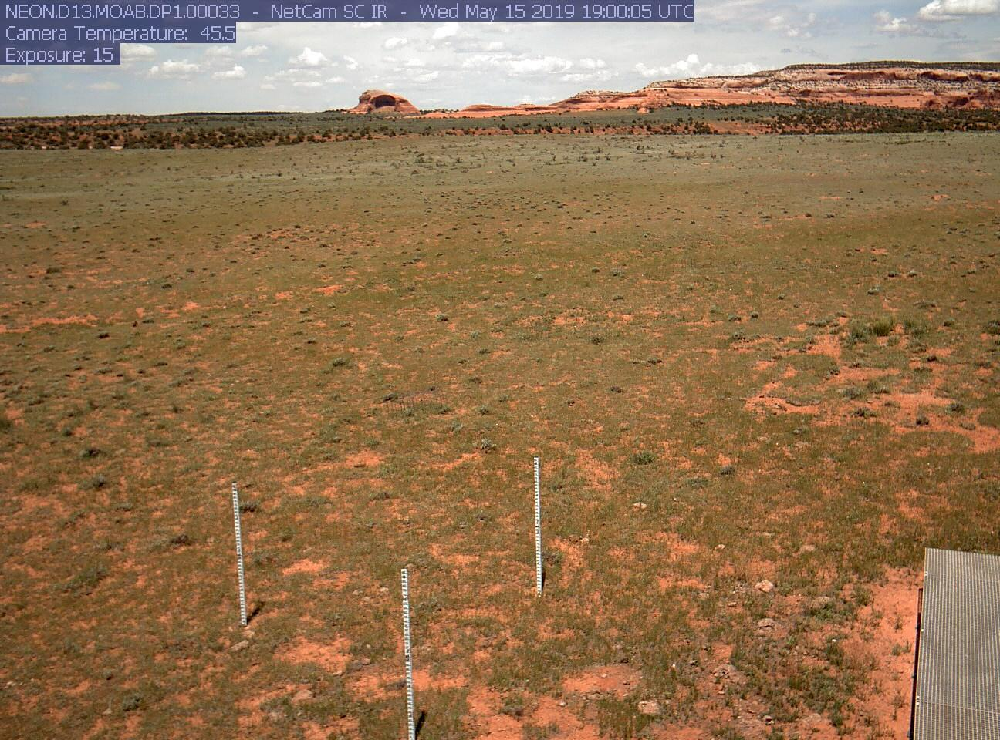
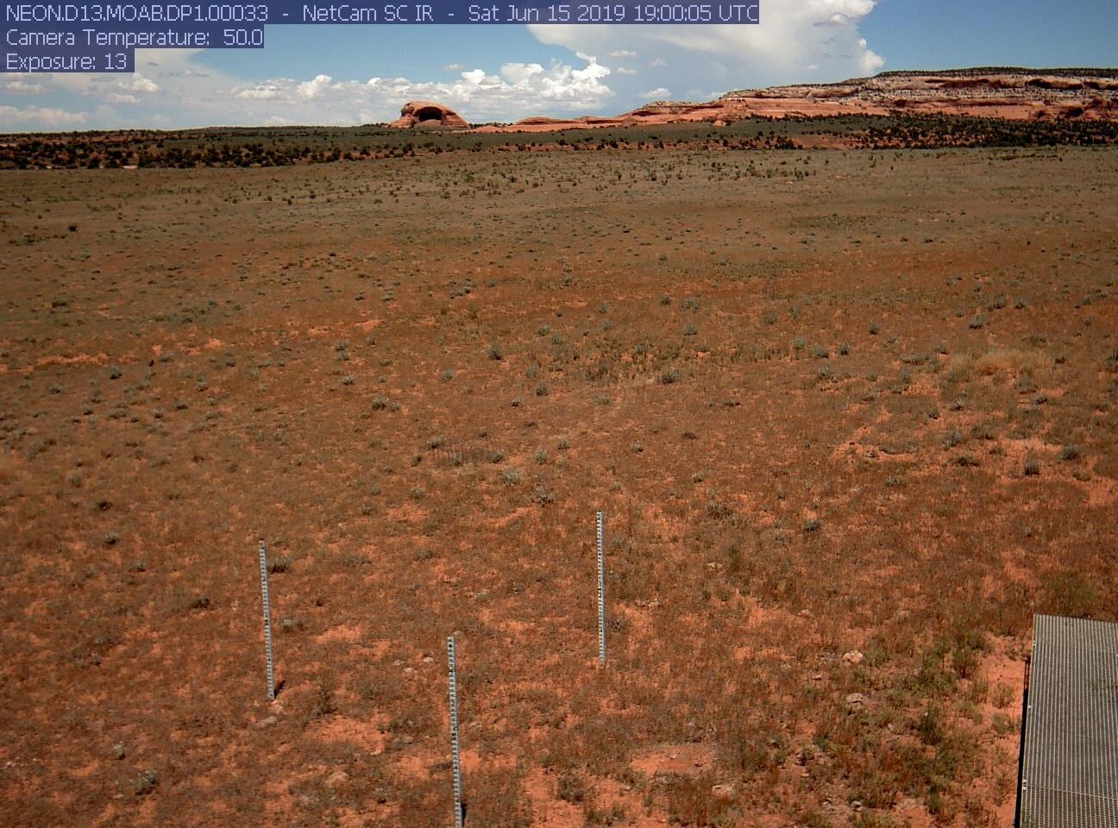
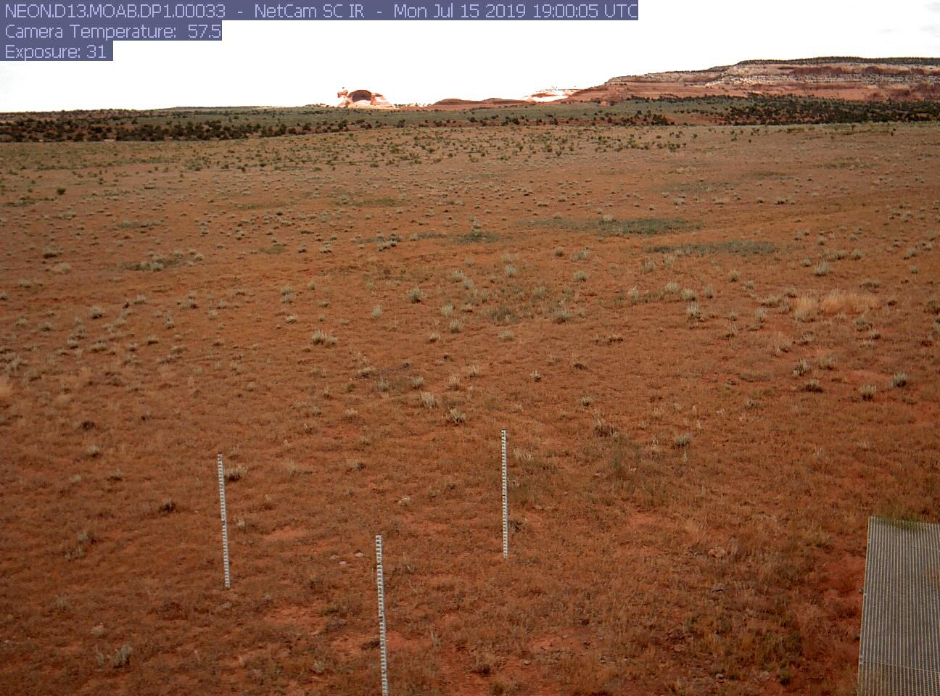
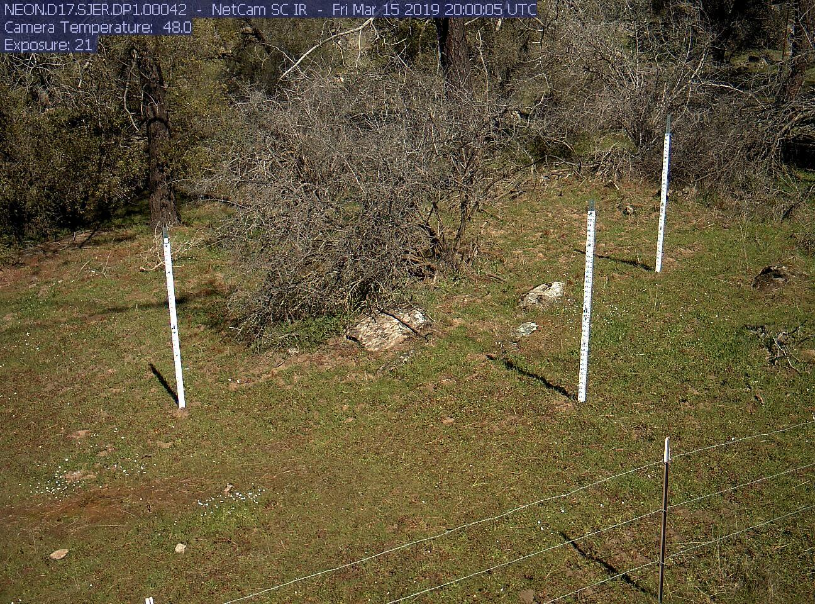
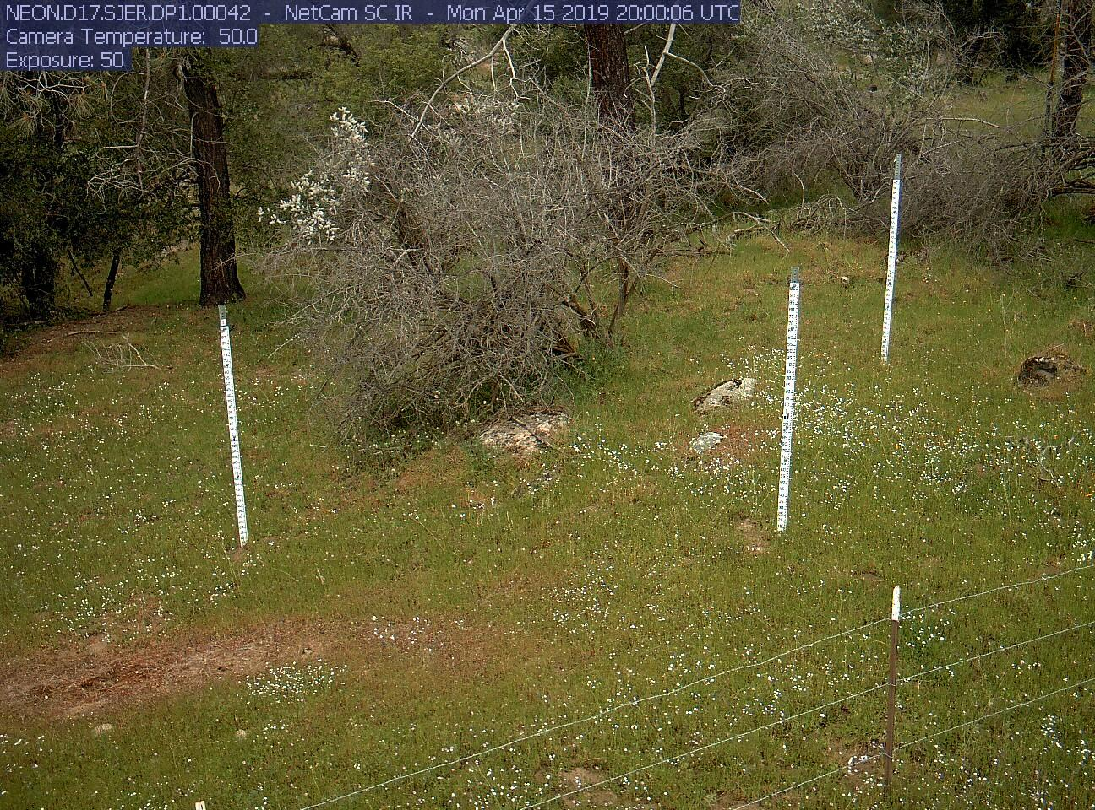
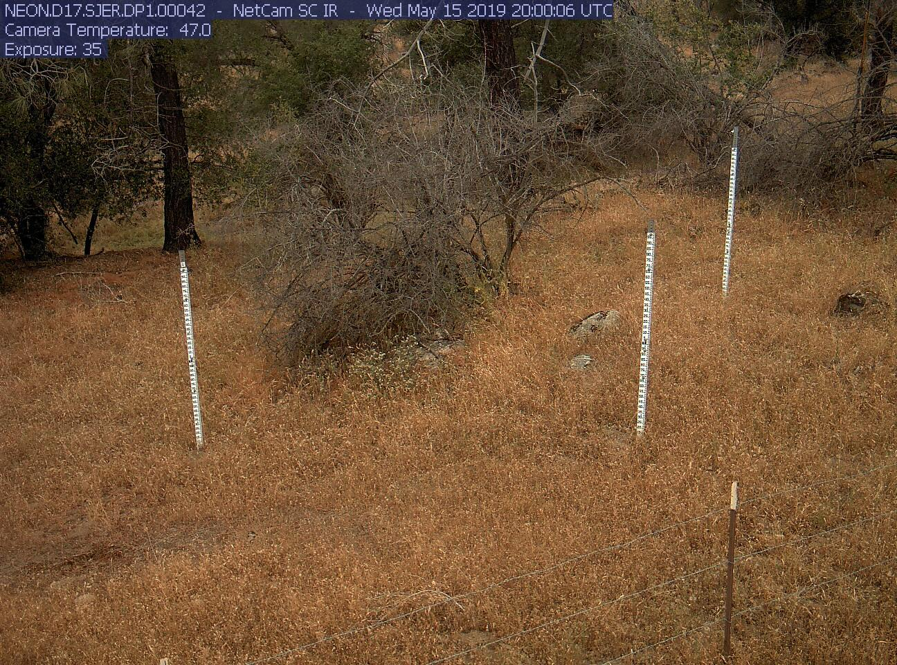
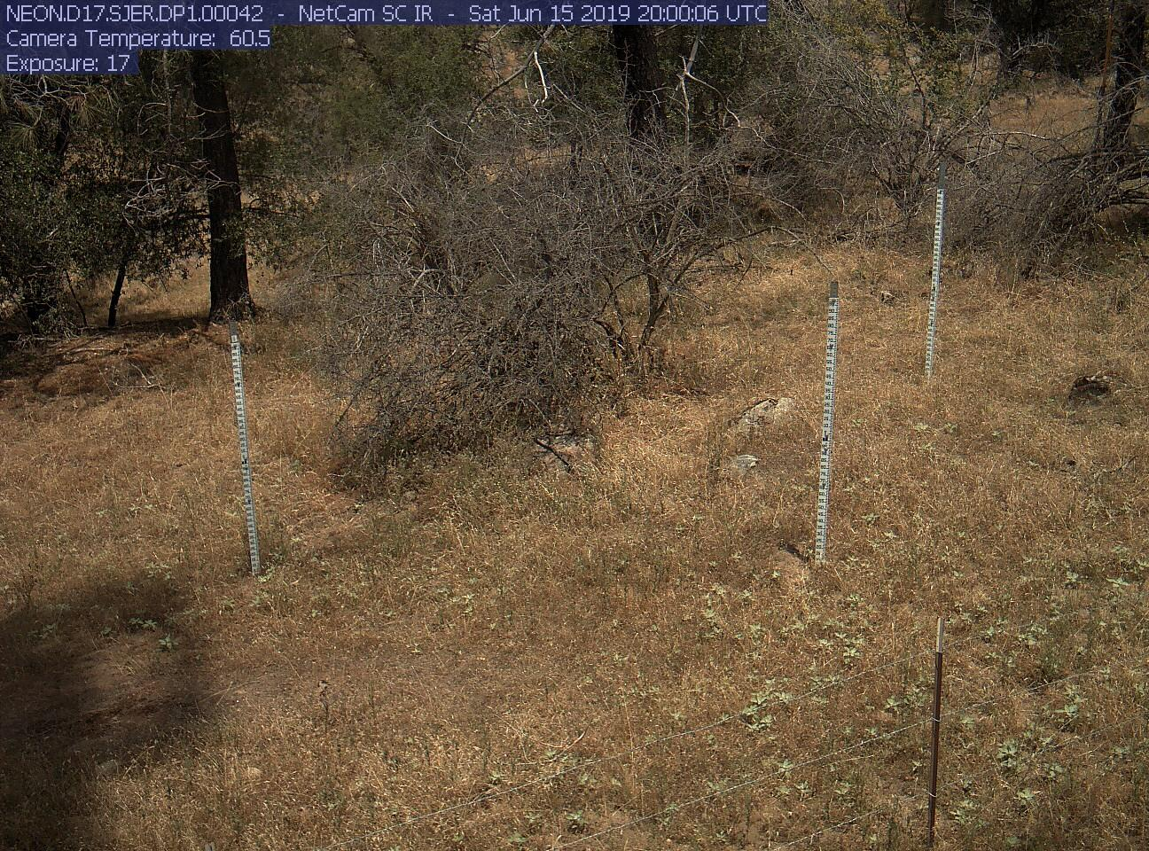
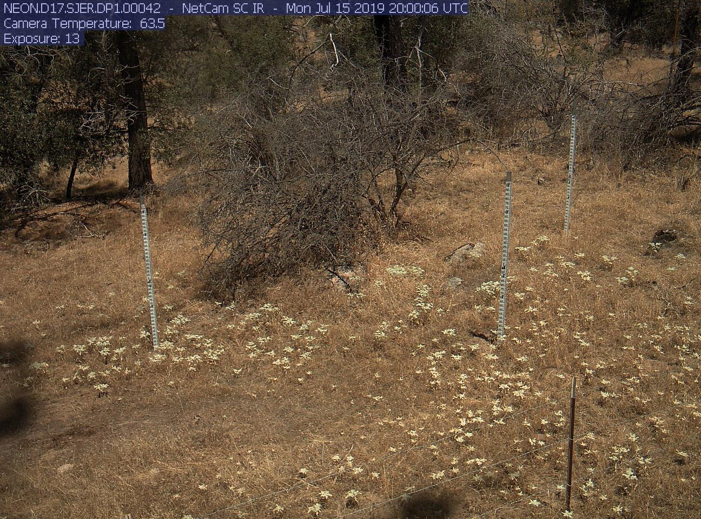
March April May June July
Notes:
Here, we have 2 different locations at 5 different months of the year. You can see that the grass in some areas grows very quickly and but then also browns down just as quickly.

Slide 9
What’s next?
Continue adding more data and locations into the Phenosynth application
Put finishing touches on the application interface
Increase the quality of the satellite imaging used in application.

Slide 10

Thank you
Notes:
Thank you so much for this wonderful opportunity!

